Slide 1
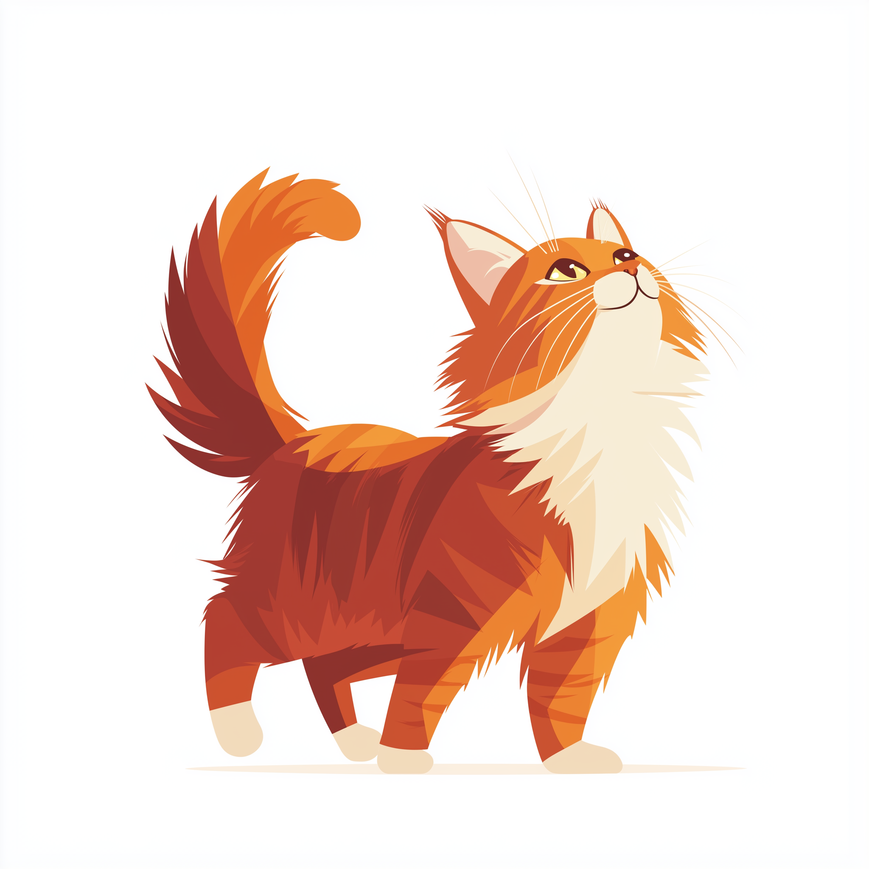
BLOCKCHAIN BASICS
…and why should I, as a veterinarian, care about them

Slide 2
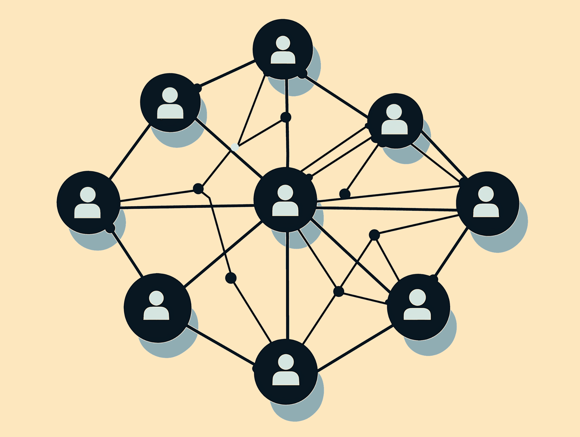
Decentralization
Unlike traditional centralized databases, blockchain data is stored across a network of nodes (computers) rather than a single server. This structure ensures that no single entity controls the network, increasing transparency, security, and resilience.

Slide 3
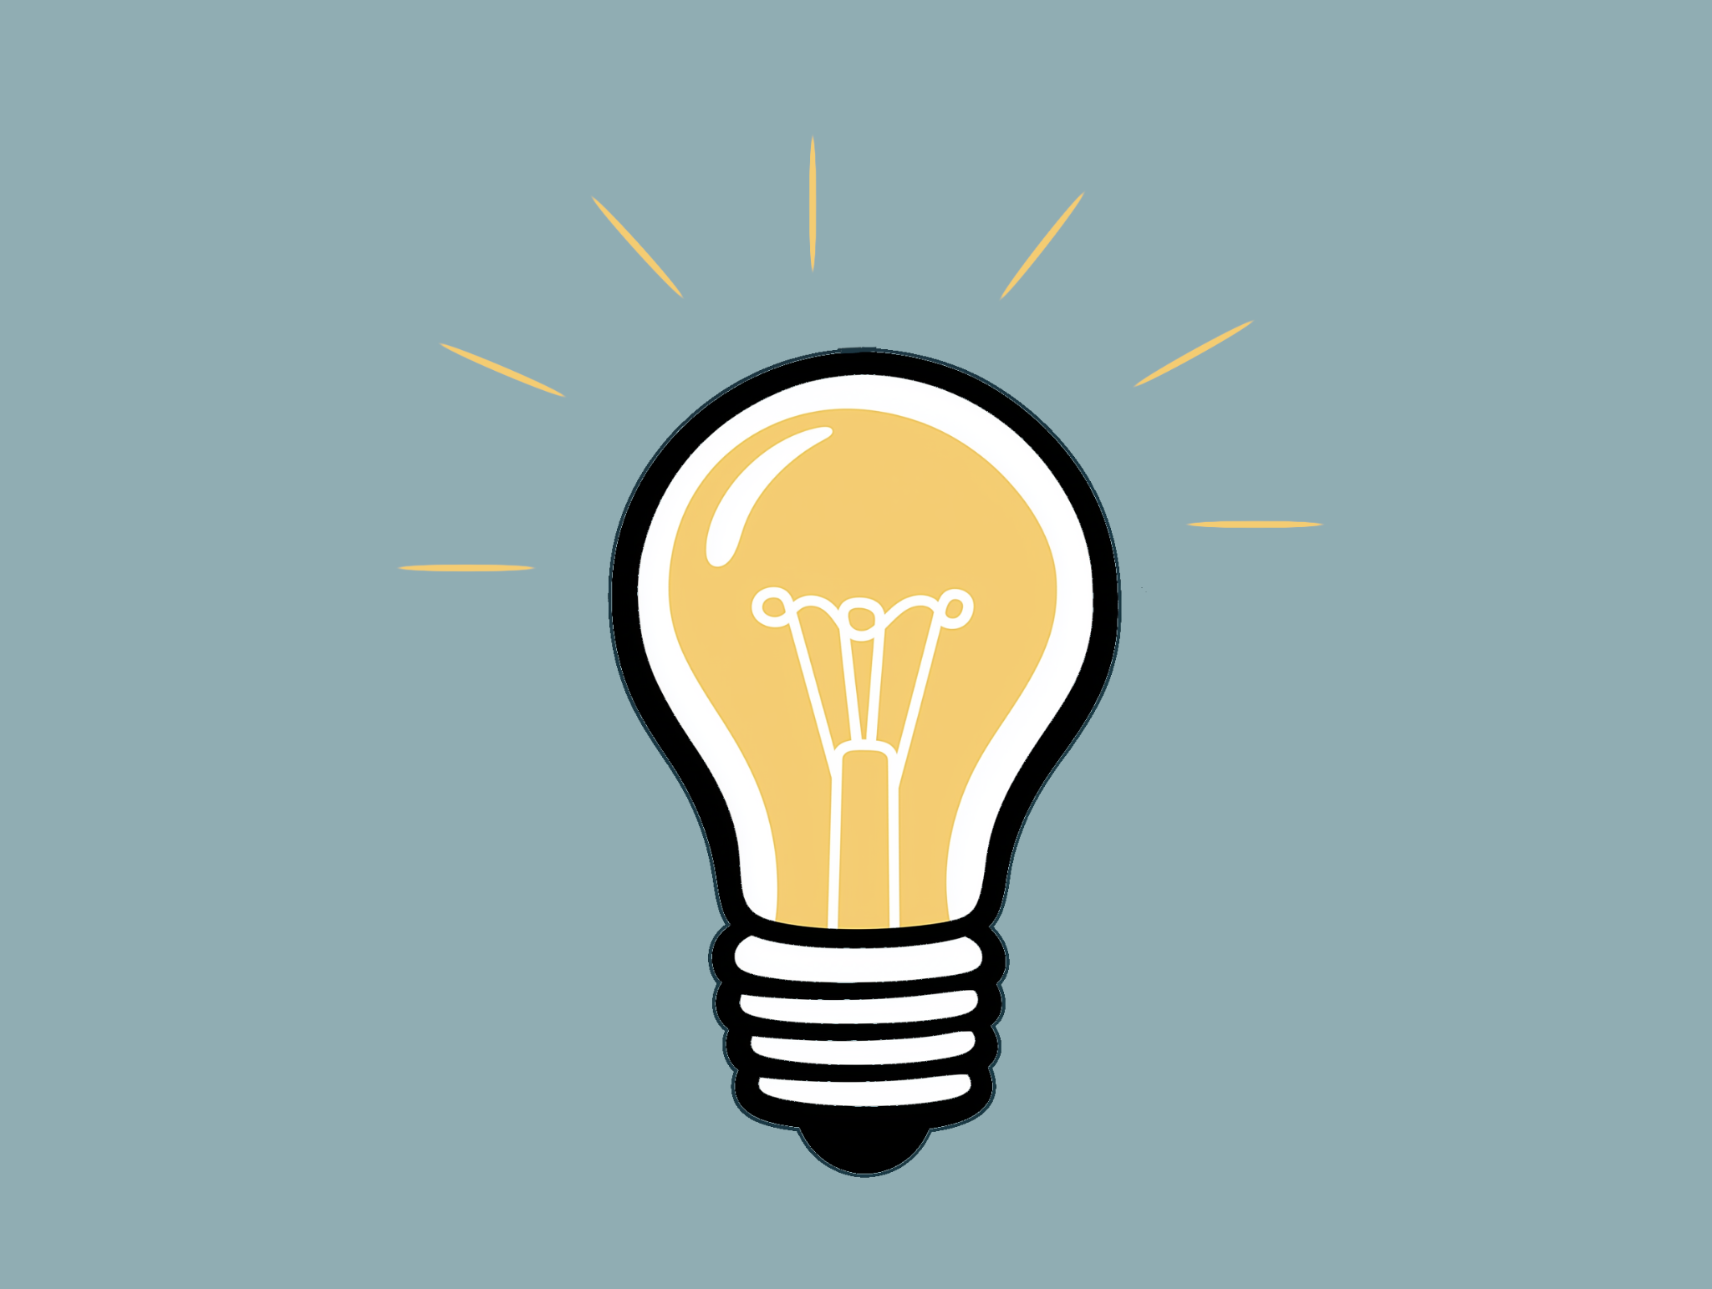
Distributed Ledger Technology (DLT)
Blockchain operates as a distributed ledger where all participants (nodes) hold a copy of the entire transaction history.
This ensures transparency, as any participant can validate data, and makes data tampering extremely challenging.

Slide 4
Cryptographic Hashing
Blockchain uses cryptographic hashing to secure data. Each block contains a unique hash (a fixed-size string generated from data) that links it to the previous block.
This chain of hashed blocks makes altering data in one block without affecting subsequent blocks highly impractical, ensuring data integrity.

Slide 5
Consensus Mechanisms
To validate and add new transactions, blockchain networks use consensus algorithms. Two common methods are:
Proof of Work (PoW): Requires miners to solve complex computational puzzles to add blocks (e.g., Bitcoin).
Proof of Stake (PoS): Validators are chosen based on their stake in the network to verify transactions (e.g., Ethereum 2.0, Cardano).
Other mechanisms include Proof of Authority (PoA), Delegated Proof of Stake (DPoS), and more.

Slide 6
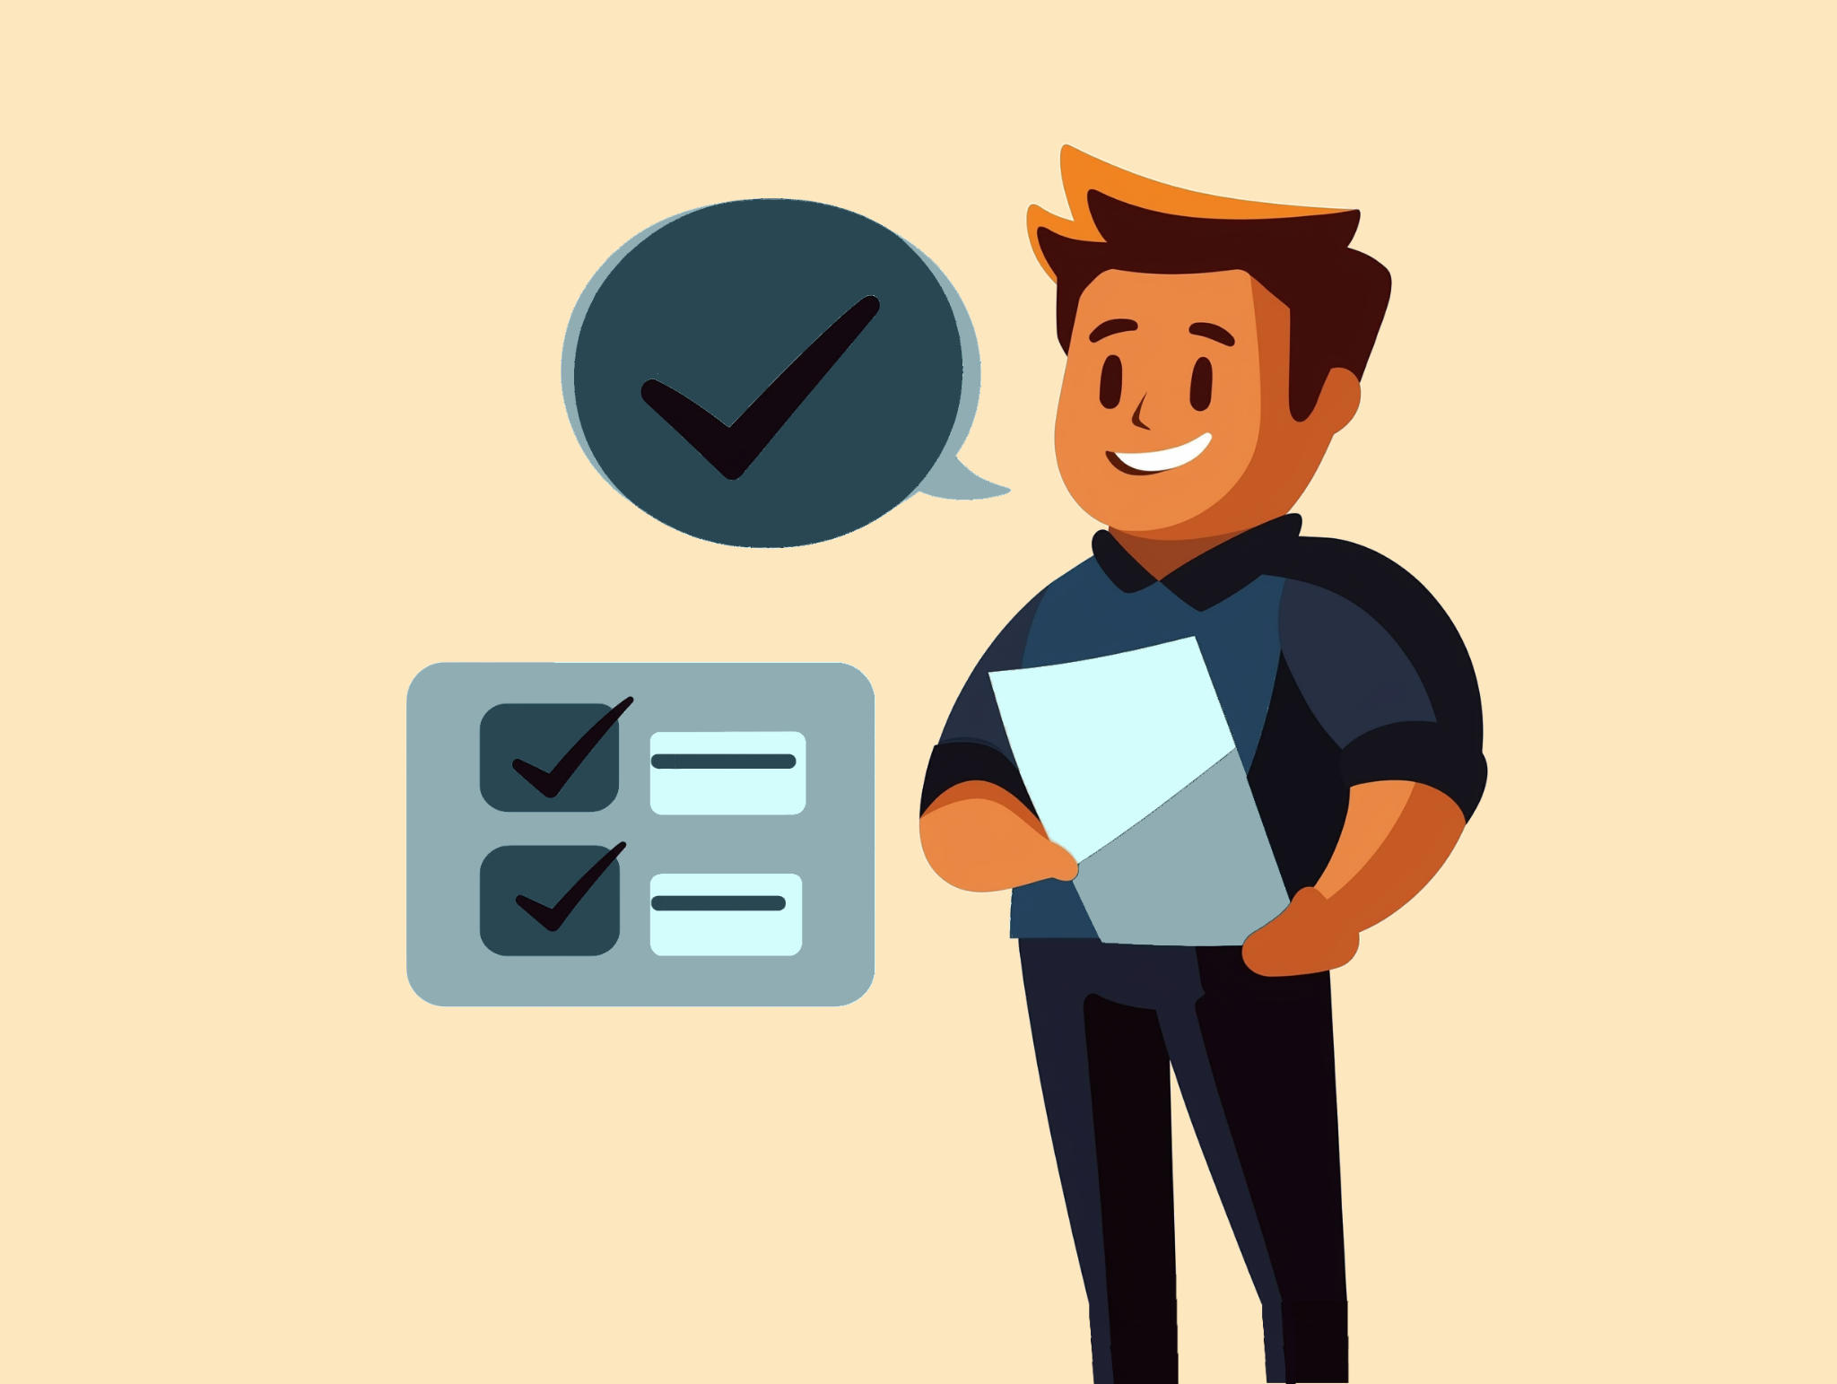
Immutability
Once data is recorded on the blockchain, it is challenging to alter or delete it. This immutability feature makes blockchain an excellent solution for applications requiring a reliable historical record, such as financial transactions or supply chain tracking.

Slide 7
Transparency and Pseudonymity
Blockchain transactions are publicly visible, but parties remain pseudonymous (known by their wallet addresses rather than identities).
This balance supports privacy while maintaining an auditable and traceable transaction history.

Slide 8
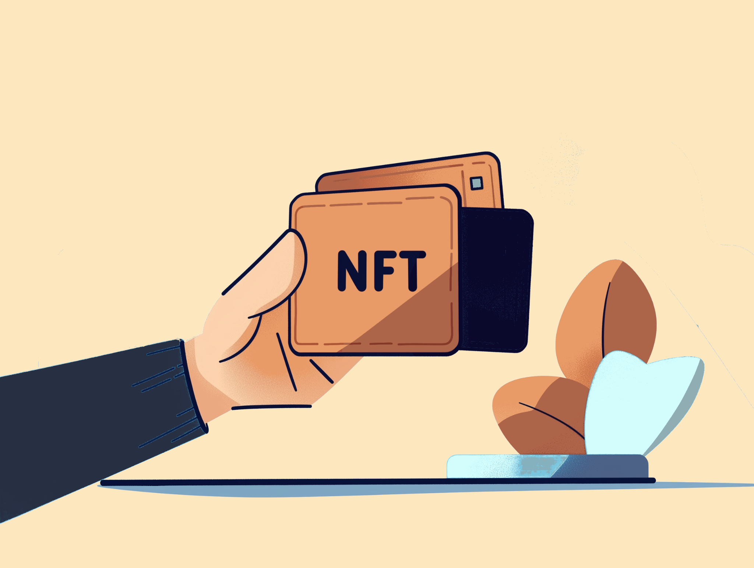
Tokenization
Blockchains can represent assets (digital or physical) as tokens, which can be exchanged on the blockchain. This enables asset ownership transfer, fractional ownership, and broadens access to investment.
Tokens can be fungible (interchangeable, like cryptocurrencies) or non-fungible (unique, like NFTs).

Slide 9
Smart Contracts
Smart contracts are self-executing contracts with the terms directly written into code. They automatically enforce and execute agreements when predetermined conditions are met, removing intermediaries and increasing process efficiency.
Ethereum popularized smart contracts, which are now widely used across different platforms.

Slide 10
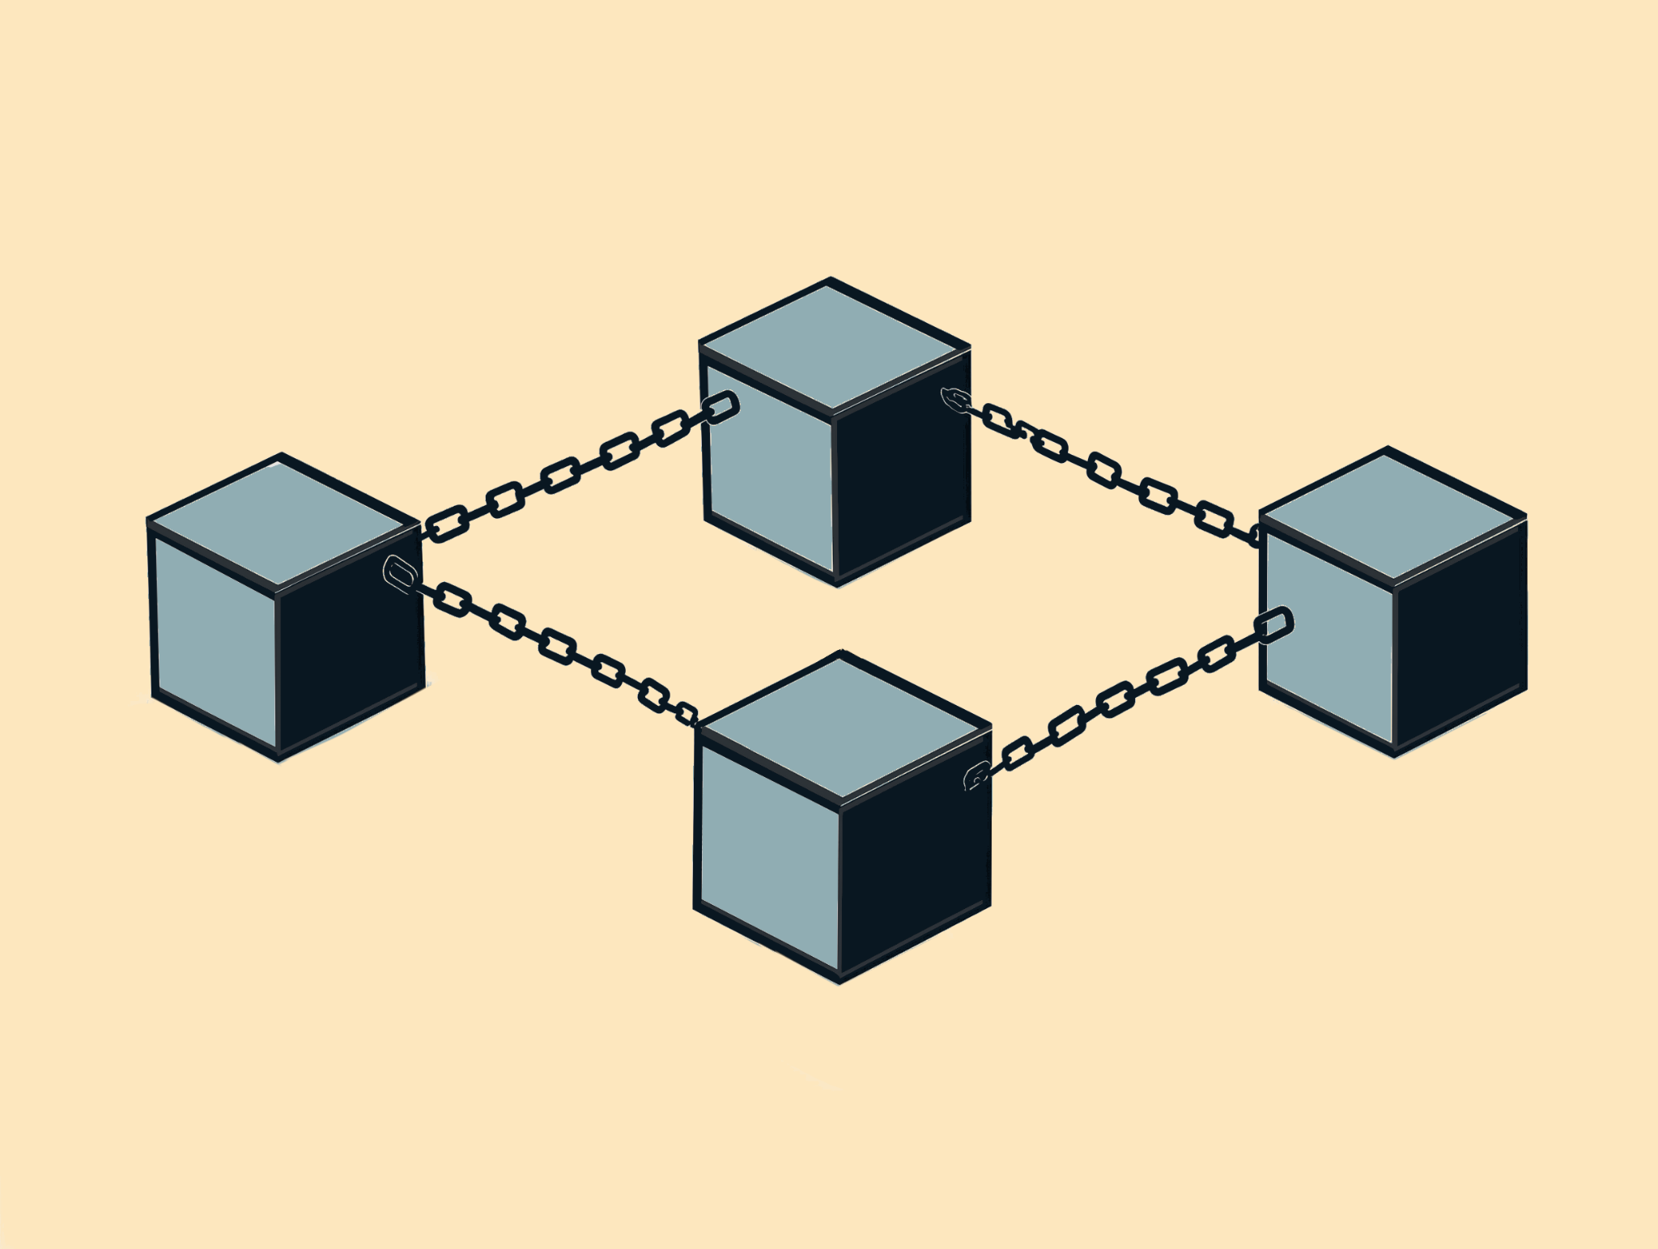
Privacy and Security
Privacy features vary across blockchains. Some, like Bitcoin, offer pseudonymity, while others, like Zcash or Monero, focus on enhancing privacy through cryptographic methods.
Security remains a primary focus, as blockchain’s decentralized and cryptographic nature makes it resistant to tampering, but issues like the "51% attack" highlight ongoing security considerations.

Slide 11
Scalability and Performance
One of the major challenges for blockchain is scalability, or the ability to handle increased transaction volume without sacrificing performance. Solutions include:
Layer 2 scaling (e.g., rollups, sidechains).
Sharding: Dividing the network into smaller parts (shards) to process transactions in parallel.
Many newer blockchains prioritize scalable consensus models to handle high transaction throughput.

Slide 12
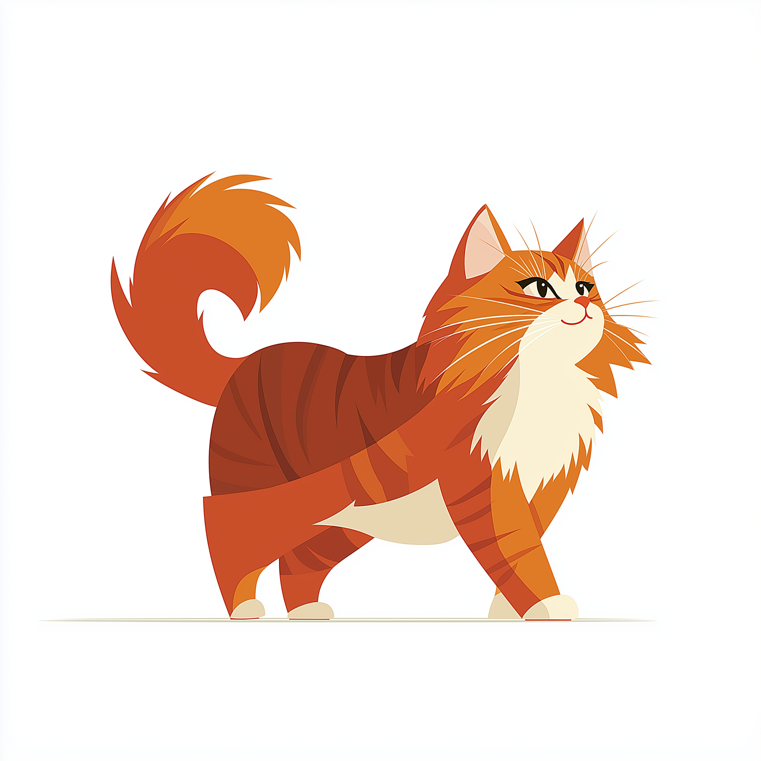
Blockchain has the potential to bring significant benefits to the veterinary profession, particularly in areas that require data transparency, secure record-keeping, and streamlined processes.

Slide 13
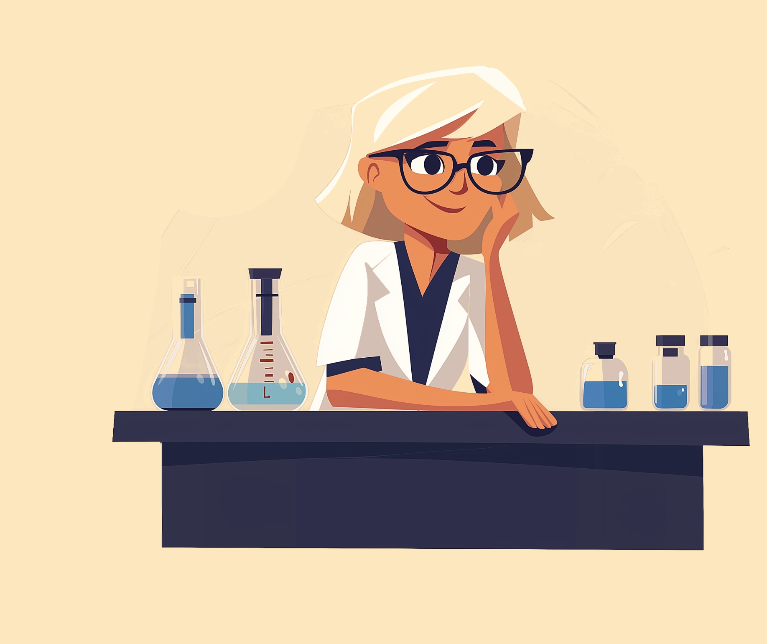
Transparent Supply Chain for Veterinary Pharmaceuticals
Blockchain can provide a traceable and transparent supply chain for veterinary drugs, ensuring authenticity and quality.
By tracking every step, from manufacturer to distributor to clinic, veterinarians can verify that the drugs they use or prescribe are genuine, safe, and stored correctly.
This reduces the risk of counterfeit medications and improves trust in the supply chain.

Slide 14
Immutable Patient Health Records
Blockchain’s immutability can help securely store patient health records, making them tamper-proof and accessible across different clinics and regions.
With permissioned access, veterinarians, pet owners, and specialists can access a pet’s complete medical history without relying on a single clinic’s system.
This can enhance continuity of care and make it easier for veterinarians to make well-informed decisions.

Slide 15
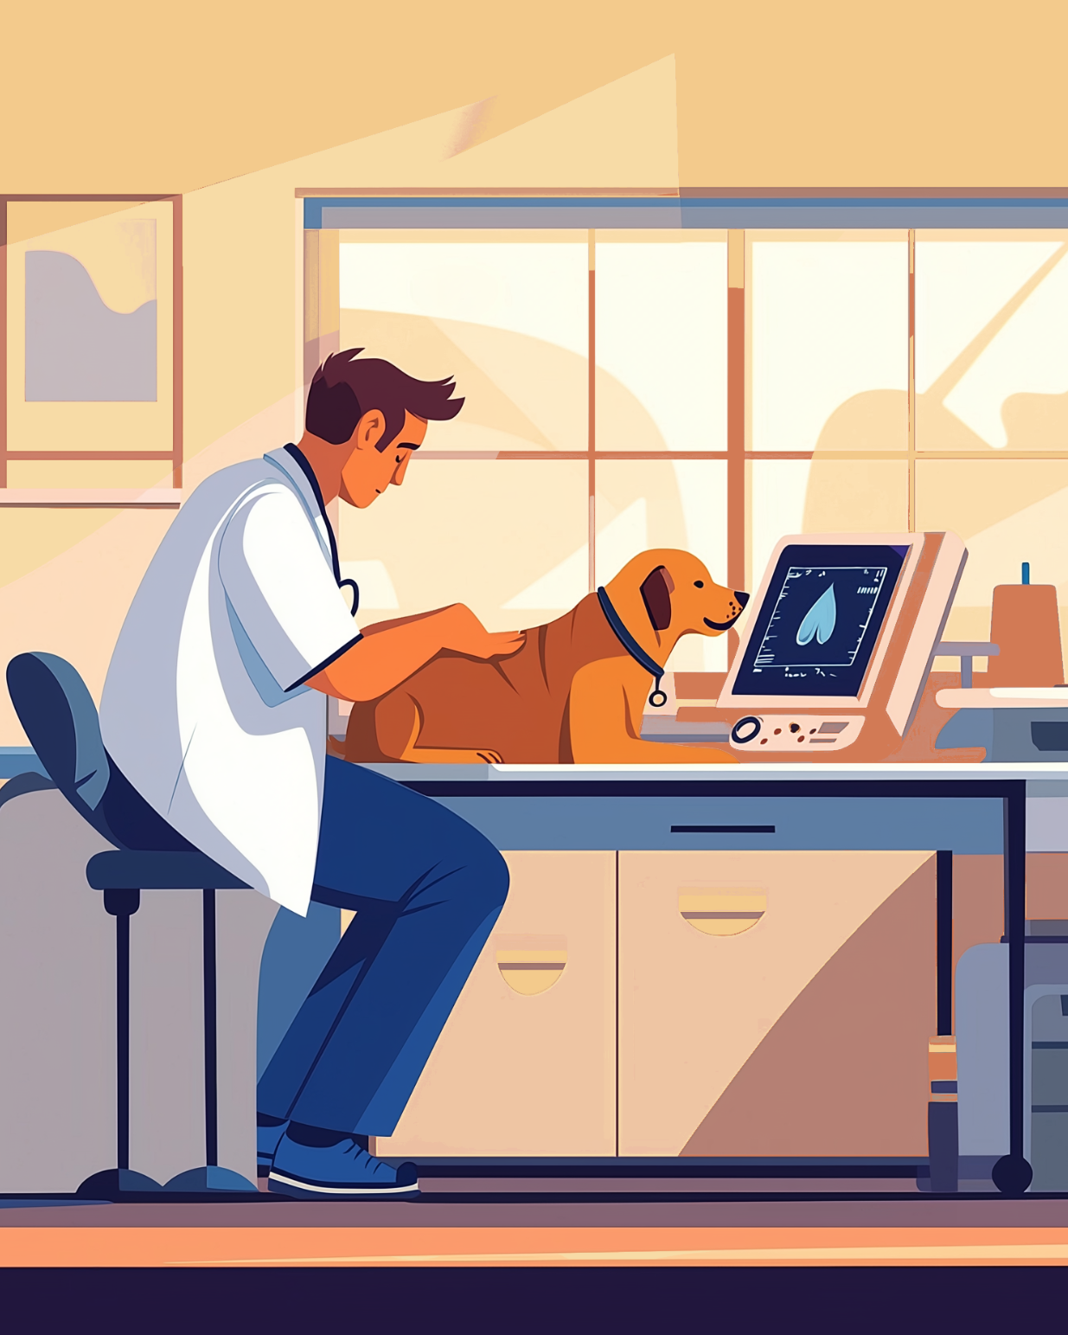
Efficient Data Sharing and Collaboration
For veterinarians working with specialists or other professionals, blockchain can facilitate the secure sharing of data.
Veterinary professionals could work together more efficiently on cases, sharing diagnostics, treatments, and outcomes without delays or data loss.
Blockchain can enable a permissioned, decentralized network, where only verified individuals can access the data while maintaining confidentiality.

Slide 16
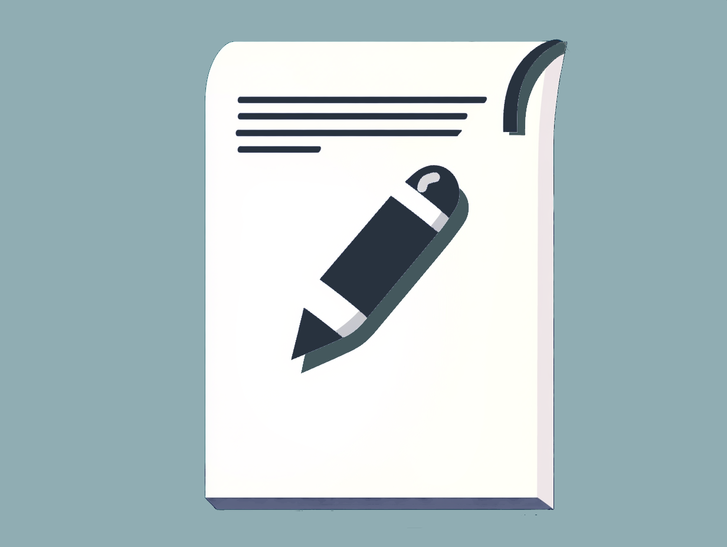
Tokenization for Research and Development Funding
Blockchain could support innovative funding models for veterinary research, such as tokenized crowdfunding or decentralized funding platforms.
Veterinarians and researchers could raise funds for specific projects (like developing treatments or studying rare conditions) by issuing tokens that represent partial ownership or support in the project, allowing people passionate about animal health to contribute.

Slide 17
Credential Verification for Veterinary Professionals
Blockchain can be used to store and verify credentials, certifications, and licenses of veterinary professionals.
It can eliminate the need for manual verification, helping clinics and organizations to confirm a veterinarian’s qualifications and licensing instantly.
This can be particularly beneficial for veterinary telemedicine services or when hiring veterinarians internationally.

Slide 18
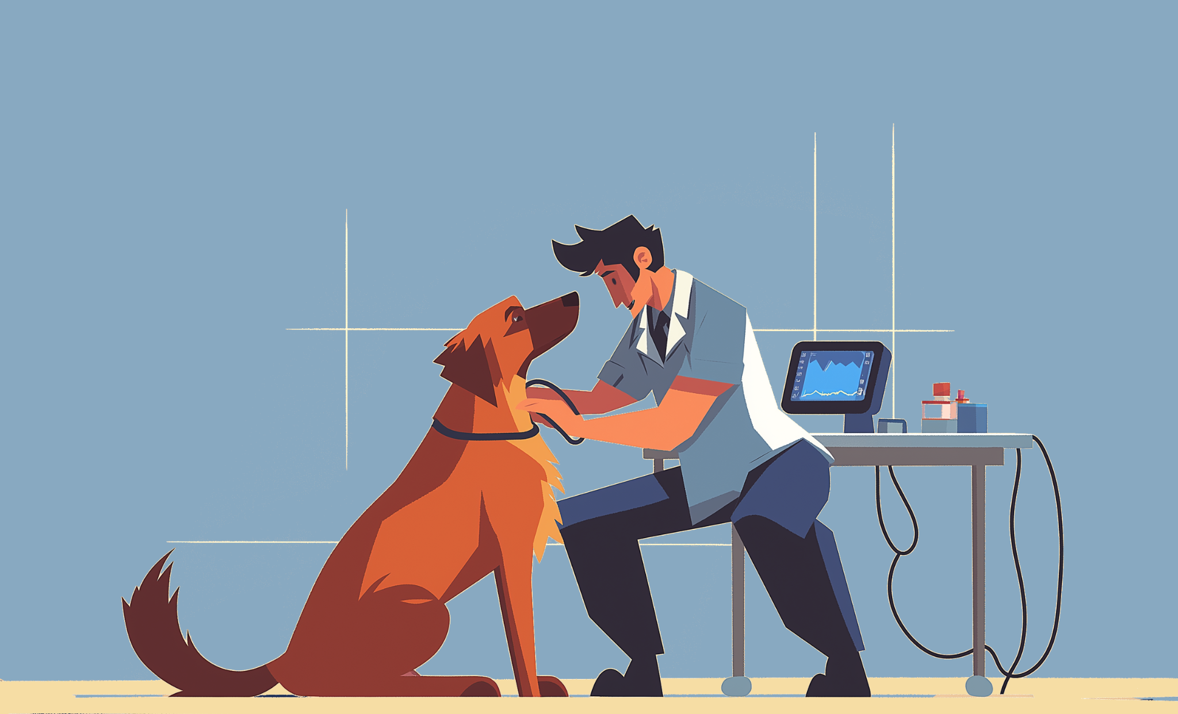
Traceability in Animal Welfare and Ethics Programs
Blockchain can track animals' care and welfare in farms, zoos, shelters, or research facilities, creating an immutable record of their treatment, health inspections, and living conditions.
For veterinarians involved in animal welfare, this transparency can improve compliance with ethical standards, support accountability, and demonstrate commitment to animal health and welfare to the public.

Slide 19
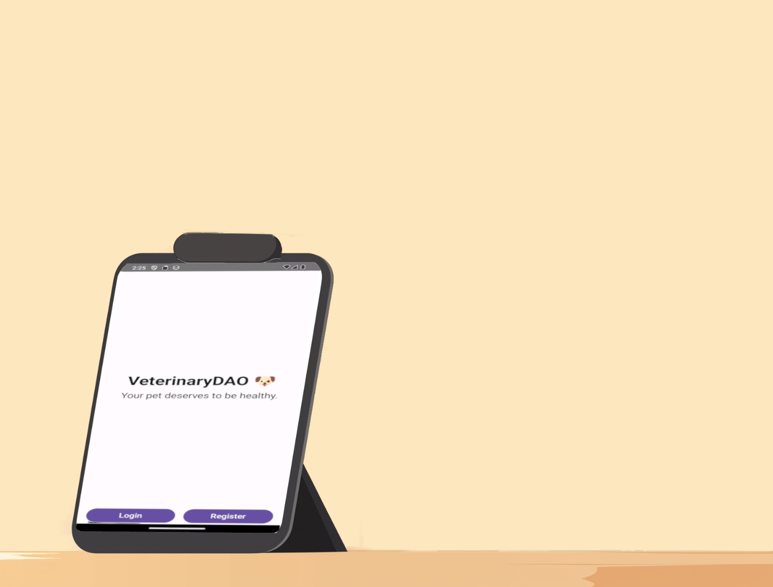
Enhanced Research Data Integrity and Collaboration
Veterinarians involved in research can benefit from blockchain’s immutable data records, which protect research integrity.
Study findings, animal health data, and research protocols stored on a blockchain can be securely shared and verified, enabling collaborative studies across institutions with high data fidelity and traceability.

Slide 20
Traceable Food Safety in Animal Agriculture
In livestock and animal agriculture, blockchain can track every step from farm to consumer, helping veterinarians ensure that animals are healthy and meet safety standards.
Blockchain’s transparency can enhance food safety, facilitate compliance with health regulations, and enable veterinarians to provide better guidance to farmers and regulators about animal health management.

Slide 21



Decentralized Knowledge Platforms
Veterinary professionals can use blockchain-based platforms to securely share case studies, treatment protocols, and research findings.
Such platforms could decentralize knowledge distribution, allowing veterinarians globally to access a reliable, verified body of knowledge to improve clinical practices and expand professional expertise without a central authority controlling the data.

